Slide 11
Critical motion sequences: varying focal length
Most important cases for varying focal length (other parameters known)
Critical motion type | ambiguity
pure rotation | arbitrary position for Π∞ (3DOF)
forward motion | proj.distortion along opt. axis (2DOF)
translation and rot. about opt. axis | scaling optical axis (1DOF)
hyperbolic and/or elliptic motion | one extra solution

Slide 12

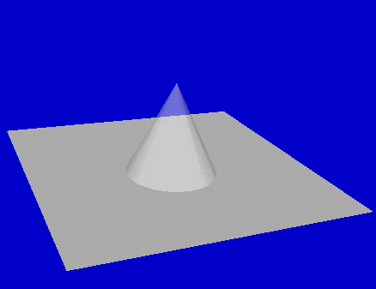
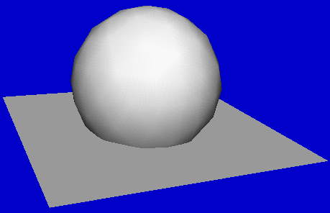
CMS: geometric insight
CMS: planar sections of imaginary cones
mapping to real geometric entities
use geometric intuition
1
x²+y²+z²=0
Imaginary cone
(back-projected
image absolute conic)
Family of
real ellipsoids

Slide 13
Critical motion sequences: varying focal length
Most important cases for varying focal length (other parameters known)
Critical motion type | ambiguity
pure rotation | arbitrary position for Π∞ (3DOF)
forward motion | proj.distortion along opt. axis (2DOF)
translation and rot. about opt. axis | scaling optical axis (1DOF)
hyperbolic and/or elliptic motion | one extra solution

Slide 14
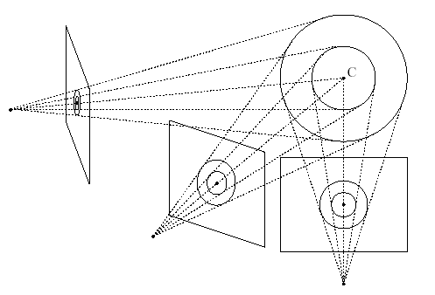
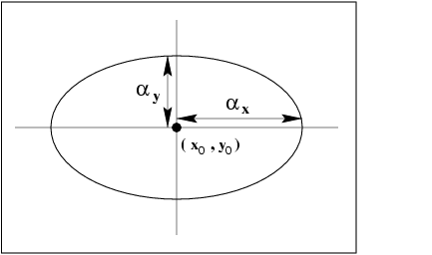
Critical motion sequences: algorithm dependent
Additional critical motion sequences can exist for some specific algorithms
  when not all constraints are enforced
  (e.g. not imposing rank 3 constraint)
  Kruppa equations/linear algorithm: fixating a point
Some spheres also project to circles located in the image and hence satisfy all the linear/kruppa self-calibration constraints

Slide 15
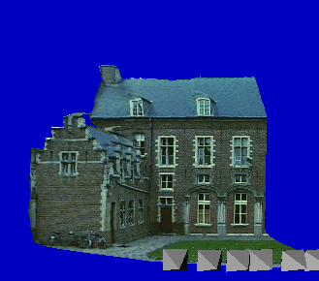
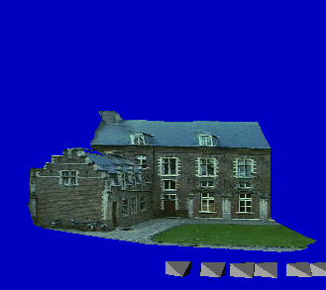
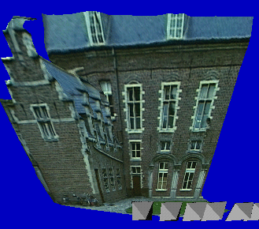
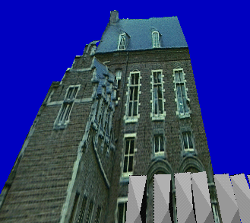
Non-ambiguous new views for CMS
(Pollefeys,ICCV´01)
restrict motion of virtual camera to CMS
use (wrong) computed camera parameters

Slide 16

Multi-view computation

Slide 17
Multiple view computation
Tensors (2,3,4-views)
Factorization
  Orthographic
  Perpective
Sequential
Bundle adjustment

Slide 18
Factorization
Factorise observations in structure of the scene and motion/calibration of the camera
Use all points in all images at the same time
Affine factorisation
Projective factorisation

Slide 19
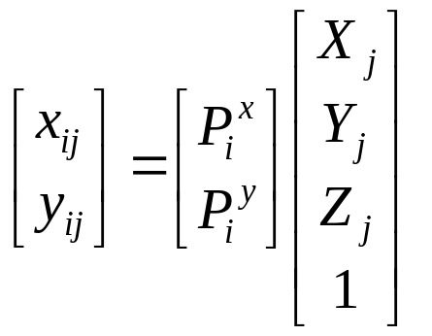
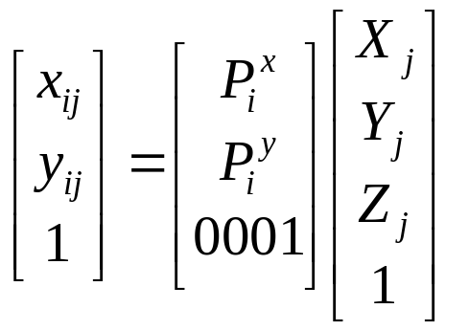
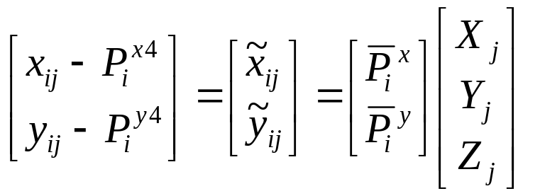
Affine camera
The affine projection equations are

Slide 20
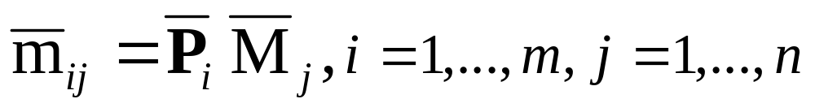
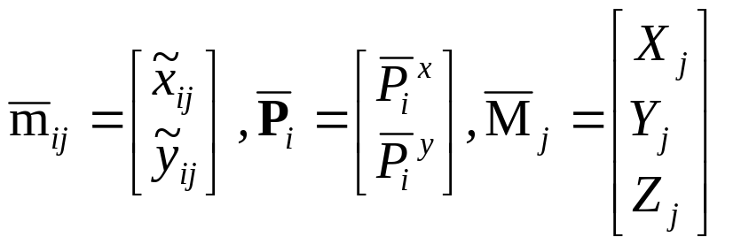
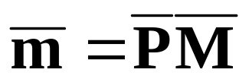
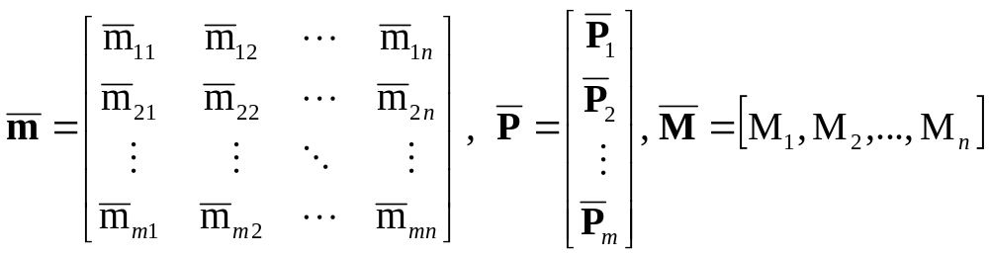
Orthographic factorization
(Tomasi Kanade’92)
The ortographic projection equations are
where
All equations can be collected for all i and j
where
Note that P and M are resp. 2mx3 and 3xn matrices and therefore the rank of m is at most 3

Slide 21
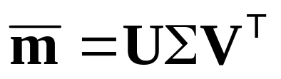
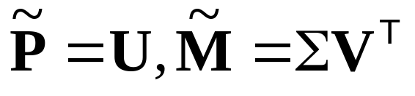
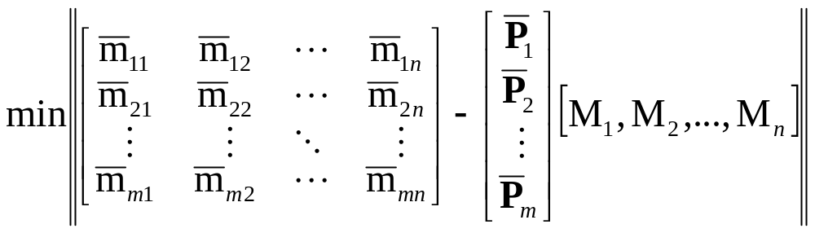
Orthographic factorization
(Tomasi Kanade’92)
Factorize m through singular value decomposition
An affine reconstruction is obtained as follows
Closest rank-3 approximation yields MLE!

Slide 22
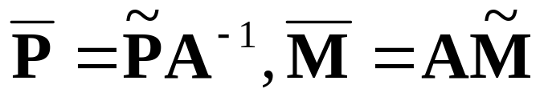
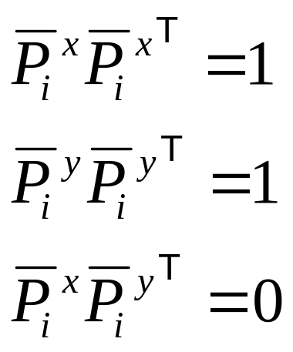
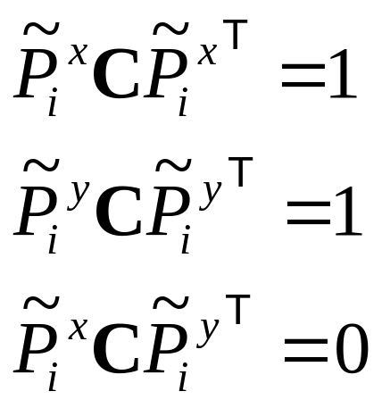
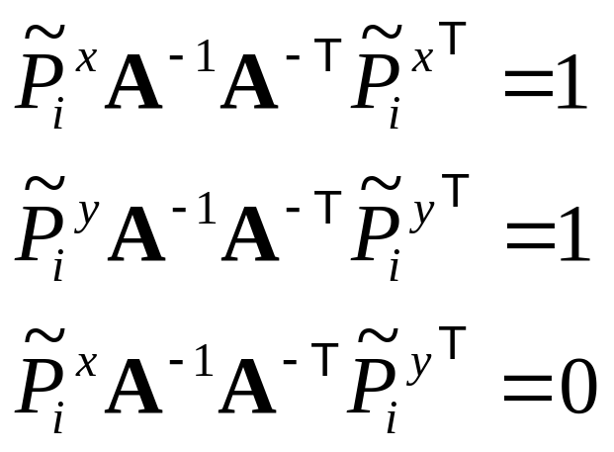
Orthographic factorization
(Tomasi Kanade’92)
Factorize m through singular value decomposition
An affine reconstruction is obtained as follows
A metric reconstruction is obtained as follows
Where A is computed from
3 linear equations per view on symmetric matrix C (6DOF)
A can be obtained from C through Cholesky factorisation
and inversion

Slide 23
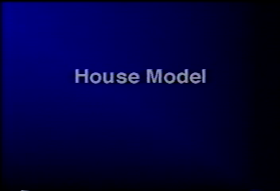
Examples
Tomasi Kanade’92,
Poelman & Kanade’94

Slide 24
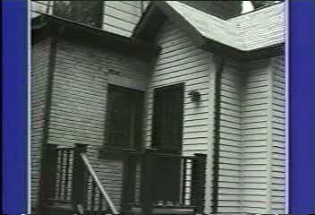
Examples
Tomasi Kanade’92,
Poelman & Kanade’94

Slide 25
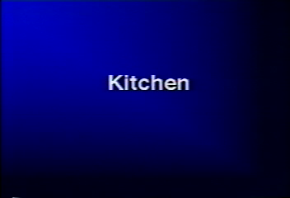
Examples
Tomasi Kanade’92,
Poelman & Kanade’94

Slide 26
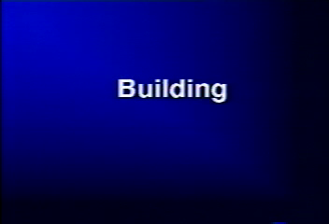
Examples
Tomasi Kanade’92,
Poelman & Kanade’94

Slide 27
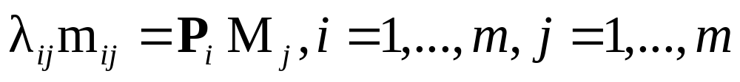
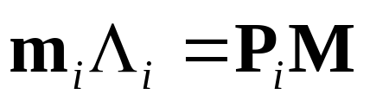
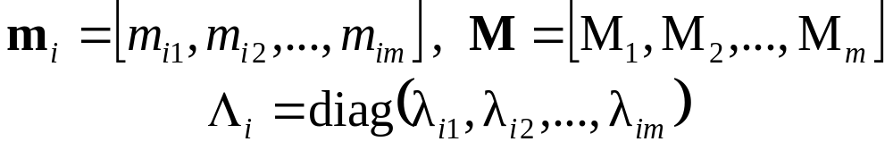
Perspective factorization
The camera equations
for a fixed image i can be written in matrix form as
where

Slide 28

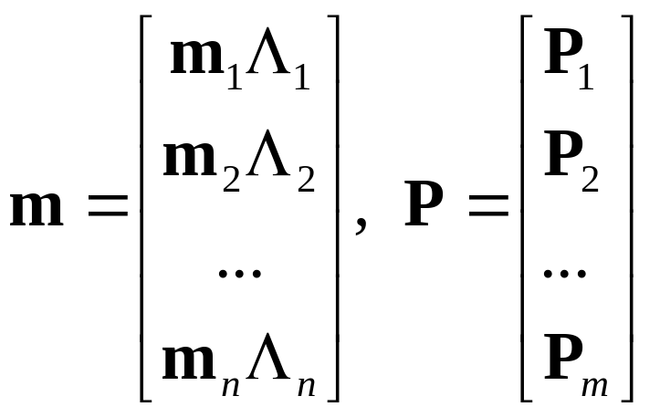
Perspective factorization
All equations can be collected for all i as
where
In these formulas m are known, but Λ_{i},P and M are unknown
Observe that PM is a product of a 3mx4 matrix and a 4xn matrix, i.e. it is a rank 4 matrix

Slide 29
Perspective factorization algorithm
Assume that Λ_{i} are known, then PM is known.
Use the singular value decomposition
PM=UΣ V^{T}
In the noise-free case
S=diag(σ₁,σ₂,σ₃,σ₄,0, … ,0)
and a reconstruction can be obtained by setting:
P=the first four columns of UΣ.
M=the first four rows of V.

Slide 30
Iterative perspective factorization
When Λ_{i} are unknown the following algorithm can be used:
1. Set λ_{ij}=1 (affine approximation).
2. Factorize PM and obtain an estimate of P and M. If σ₅ is sufficiently small then STOP.
3. Use m, P and M to estimate Λ_{i} from the camera equations (linearly) m_{i} Λ_{i}=P_{i}M
4. Goto 2.
In general the algorithm minimizes the proximity measure P(Λ,P,M)=σ₅
Note that structure and motion recovered up to an arbitrary projective transformation

Slide 31
Further Factorization work
Factorization with uncertainty
Factorization for dynamic scenes
(Irani & Anandan, IJCV’02)
(Costeira and Kanade ‘94)
(Bregler et al. 2000,
Brand 2001)

Slide 32
Sequential structure from motion
Initialize structure and motion from two views
For each additional view
  Determine pose
  Refine and extend structure
Determine correspondences robustly by jointly estimating matches and epipolar geometry

Slide 33
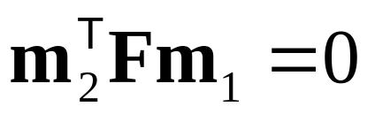
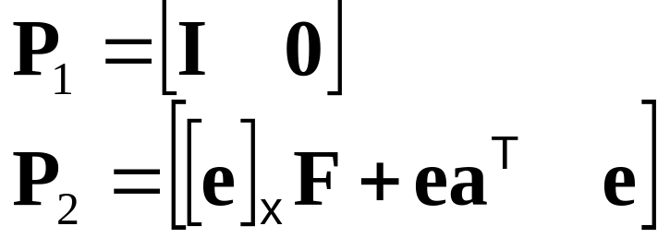
Initial structure and motion
Epipolar geometry ↔ Projective calibration
compatible with F
Yields correct projective camera setup
(Faugeras´92,Hartley´92)
Obtain structure through triangulation
Use reprojection error for minimization
Avoid measurements in projective space

Slide 34
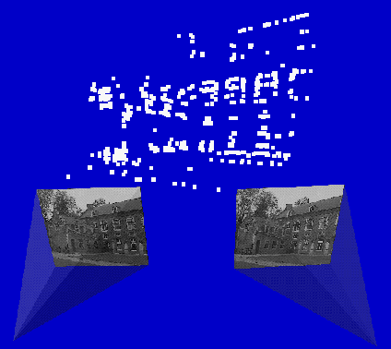

Determine pose towards existing structure
M
2D-3D
2D-3D
m_{i+1}
m_{i}
2D-2D
new view
Compute Pi+1 using robust approach
Find additional matches using predicted projection
Extend, correct and refine reconstruction

Slide 35
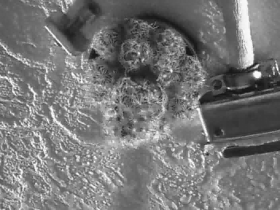
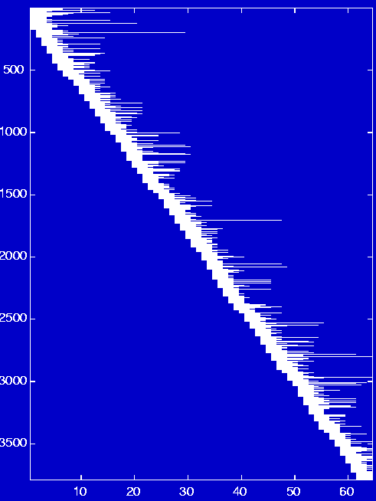
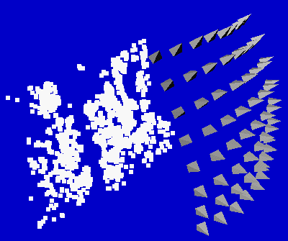
Non-sequential image collections
Problem:
Features are lost and reinitialized as new features
3792 points
Solution:
Match with other close views
4.8im/pt
64 images

Slide 36
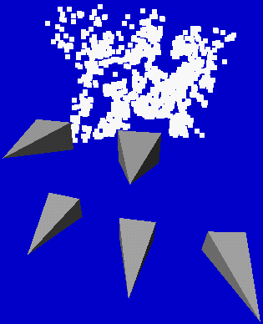
Relating to more views
For every view i
  Extract features
  Compute two view geometry i-1/i and matches
  Compute pose using robust algorithm
  For all close views k
    Compute two view geometry k/i and matches
    Infer new 2D-3D matches and add to list
  Refine pose using all 2D-3D matches
  Refine existing structure
  Initialize new structure
For every view i
  Extract features
  Compute two view geometry i-1/i and matches
  Compute pose using robust algorithm
  Refine existing structure
  Initialize new structure
Problem:
find close views in projective frame

Slide 37

Determining close views
If viewpoints are close then most image changes can be modelled through a planar homography
Qualitative distance measure is obtained by looking at the residual error on the best possible planar homography
Distance =

Slide 38
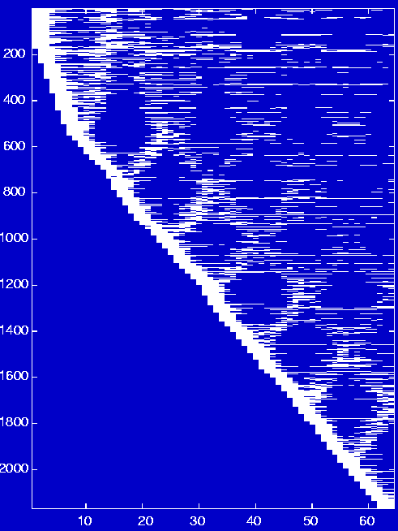
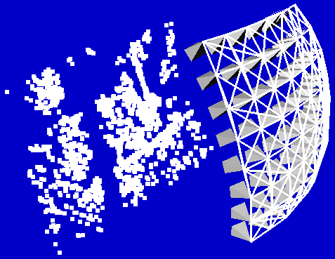
Non-sequential image collections (2)
3792 points
2170 points
9.8im/pt
64 images
4.8im/pt
64 images

Slide 39
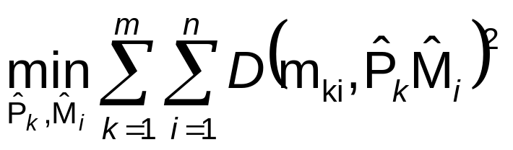
Refining structure and motion
Minimize reprojection error
  Maximum Likelyhood Estimation (if error zero-mean Gaussian noise)
  Huge problem but can be solved efficiently (Bundle adjustment)

Slide 40
Next class: bundle adjustment

